Slide 1






A new generation
of tech specialists

Slide 2
Real-Time Air Quality
Prediction & Classification
System

Slide 3
Outline
Concept note and implementation plan:​
Background​
Objectives​
SDG Relation​
Data​
Data Collection​
Exploratory Data Analysis (EDA) and Feature Engineering​
Model Selection and Training​
Model Evaluation and Hyperparameter Tuning​
Model Refinement and Testing​
Results​
Deployment​
Future Work

Slide 4
Background
• Project Overview:
Real-time air quality prediction and classification system designed to monitor and assess air pollution levels.
Uses data from local sources (NEPA) and global weather databases (OpenWeather API) to predict air quality of Kabul and worldwide in sex different time forecasting.
• Problem Statement:
Air pollution is a growing concern in urban areas, significantly impacting public health and the environment.
Lack of real-time monitoring systems to predict and classify air quality, leaving communities vulnerable to harmful pollution levels.

Slide 5
Background
• Importance of the Problem:
Health Impact: Poor air quality contributes to respiratory diseases, cardiovascular conditions, and premature deaths.
Environmental Damage: Air pollution harms ecosystems, contributing to climate change and biodiversity loss.
Need for Action: Timely predictions and warnings can help policymakers and the public take preventative measures to reduce exposure and mitigate harm.

Slide 6
Objectives
Real-time Air Quality Prediction:
Develop a machine learning model that predicts air quality in real-time based on historical and live data.
Pollution Classification:
Classify air quality into categories (e.g., good, moderate, unhealthy) to help the public and policymakers understand the current state of air pollution.
Data Integration:
Combine local and global datasets (NEPA and OpenWeather API) to create a comprehensive system for air quality prediction.
Actionable Insights for Public Health:
Provide insights into pollution trends to inform health warnings and encourage actions to reduce exposure.
Support Decision-Making:
Equip local authorities with data-driven predictions to aid in developing policies and interventions for cleaner air.

Slide 7
SDG Relation
SDG 3 – Good Health & Well-being
Air pollution is a major cause of respiratory diseases, heart conditions, and other health issues.
Our system helps monitor and predict air quality, enabling people to take necessary precautions and reduce health risks.
SDG 11 – Sustainable Cities & Communities
Provides data-driven insights to help city planners, environmental agencies, and policymakers improve urban air quality.
Helps in reducing pollution exposure, making cities safer and more livable.
SDG 13 – Climate Action
Tracks air pollutants like NO2, O3, and PM2.5, which are key contributors to climate change.
Enables real-time monitoring to support climate policies and mitigation efforts.

Slide 8
Data

Slide 9
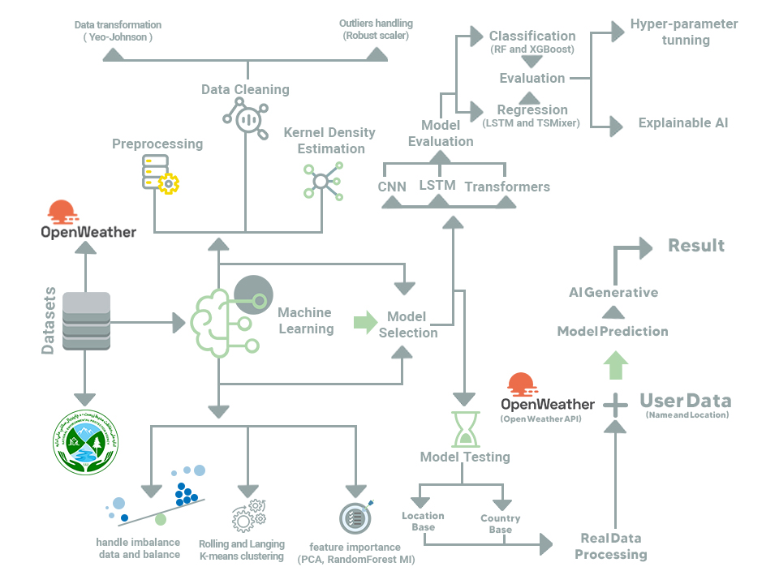
Model Flowchart

Slide 10
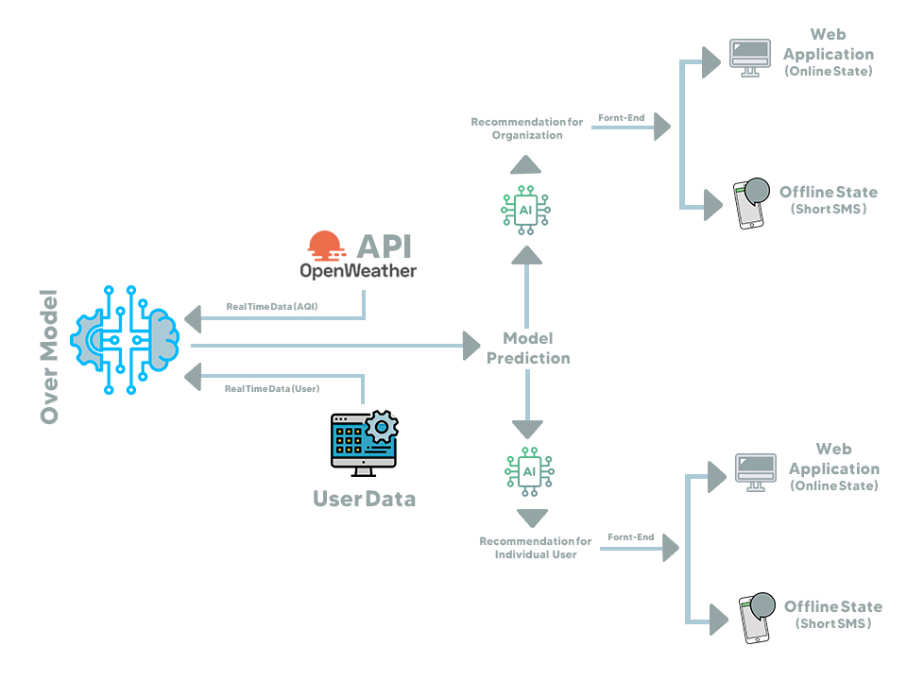
App Flowchart

Slide 11
Data
📌 Data Sources:
NEPA Dataset 🇦🇫 (National Environmental Protection Agency – Kabul)
o Provides historical air quality data for pollutants such as PM2.5, NO2, O3, CO, SO2.
o Some data gaps required augmentation and imputation.
OpenWeather API 🌍
o Provides real-time air quality and meteorological data for various pollutants.
o Chosen due to accessibility, as other high-quality air pollution datasets required payment.

Slide 12
Data
Data Preprocessing Steps:
• Standardization & Formatting
o Converted all timestamps into a consistent format (UTC).
o Merged NEPA and OpenWeather data for a comprehensive dataset.
• Handling Missing Values
o NEPA dataset had missing pollutant values → Imputed using KNN imputation.
o For pollutants like NO & NH3, values were extracted from OpenWeather using FTLRI method.
• Handling Outliers
o Outliers in pollutant levels were addressed using:
▪ Yeo-Johnson Transformation for skewed distributions.
▪ Robust Scaling to normalize extreme values.
• Feature Engineering
o Extracted time-based features (Year, Month, Day, Hour) for better trend analysis.
o Geospatial Clustering: Grouped latitude & longitude into regional clusters for localized analysis.

Slide 13
Model

Slide 14
Model Selection and Training/Testing
Model | Purpose | Strengths | Weaknesses
LSTM (Long Short-Term Memory) | Time-series prediction | Captures long-term dependencies, effective for sequential data | Computationally expensive, risk of overfitting
TSMixer | Time-series regression | Handles structured tabular time-series data efficiently | Requires fine-tuning for optimal performance
Random Forest Classifier | Classification (AQI categories) | Strong generalization, robust to noise | Computationally intensive for large datasets
CNN (Convolutional Neural Networks) | Feature extraction | Effective for high-dimensional data | Needs a large labeled dataset
Reinforcement Learning (PPO) | Feature robustness & adaptive learning | Improves long-term predictions | Resource-intensive, complex to implement

Slide 15
Model Selection and Training/Testing
Model Training & Hyperparameter Tuning
• Cross-Validation: Applied K-fold (10 folds) to improve generalization.
• Hyperparameter Optimization:
o RandomForestClassifier: Tuned n_estimators, max_depth using GridSearchCV.
o LSTM: Tuned number of layers, neurons per layer, dropout rate using early stopping.
o TSMixer: Optimized layer size for better regression performance.

Slide 16
Model Selection and Training/Testing
Model Performance Comparison on Classification
Model | Training Accuracy | Testing Accuracy | Overfitting Risk?
LSTM | 91.82% | 92.26% | No
Transformers | 75.59% | 75.73% | No
CNN | 93.36% | 94.53% | No
Hybrid | 94.29% | 94.63% | No

Slide 17
Model Selection and Training/Testing
Visualizations & Insights
✅ Feature Correlation Heat map (Shows relationships between pollutants)
✅ Confusion Matrix (Evaluates classification performance)
✅ Prediction vs. Actual Scatter Plot (Regression model performance)

Slide 18
Model Selection and Training/Testing
Best Classification & Regression Models
Model | Training Evaluation metrics (Accuracy) / MAE, MSE | Testing Evaluation metrics (Accuracy) / MAE, MSE | Overfitting Risk?
RandomForest | 99.79% | 99.5% | No
TSMixer | 0.08 | 0.07 | No

Slide 19
Result

Slide 20
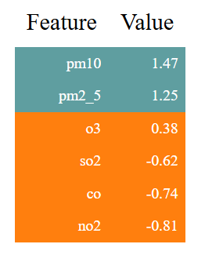
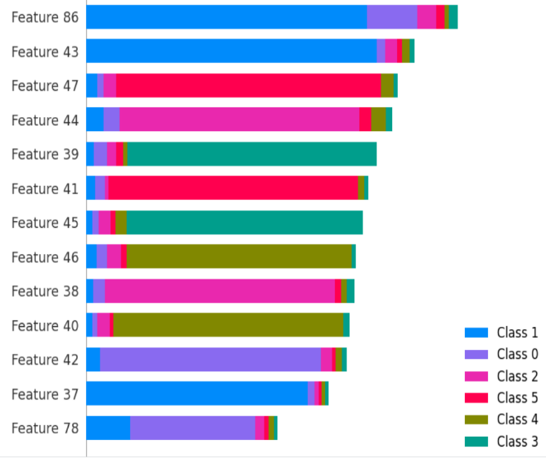
Evaluation Results
Best Classification & Regression Models
Regression XAI
Classification XAI
Model | Training Evaluation metrics (Accuracy) / MAE | Testing Evaluation metrics (Accuracy) / MAE | MSE / R^2
RandomForest | 99.79% | 99.5% | No
TSMixer | 0.08 | 0.07 | 0.02 / 0.98

Slide 21
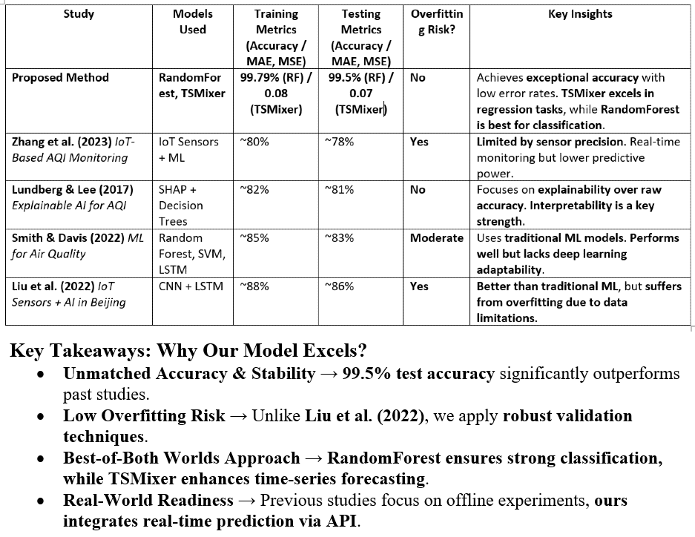
Proposed Method Comparison

Slide 22
Deployment

Slide 23
Deployment
Openweahter & User data API --> Preprocess API --> Prediction & Classification and recommendations.
Through web applications goes to individuals and organizations and offline state through SMS.
Classification & regression run together:
Regression → Reinforcement Learning (PPO)
Classification → OpenAI API for generation
Hosted on GitHub
Hosted on Railway server.

Slide 24
Conclusion and Futurework
Great model performance on both Classification & Regression.
Real time Classification, Forecasting and suggestion can help people and policy makers to reduce the pollution sources and make a better life for everyone.
Giving API to companies and individual for real time forecasting and suggestion.
Building Mobile APP.
Giving access to models outcome even you are offline.

Slide 25


Thank you!

